Slide 1

HR ANALYSIS REPORT

Slide 2

OUTLINE
1.Executive Summary
2.Introduction
3.Methodology
4.Result
4.1.Charts
4.2.Dashboard
5.Discussion
6.Conclusion

Slide 3

1.EXECUTIVE SUMMARY
Overview about Human Resources Management in company.
Find the employees termination reasons and give the solution

Slide 4

2. INTRODUCTION
Identify number of employees still employed or terminated by gender, position and department.
Tell the top termination reasons.
From top reasons and satisfaction chart, give solution.

Slide 5

3. METHDOLOGY
Data Collection
+ Collecting Data from Kaggle
Data Wrangling
+ Convert Data Type (using Cast or Convert in SQL)
+ Breaking out a clolumn into individuals columns using Substring and Charindex
- Exploratory Data Analysis
+ Analyze, explore data (using View and Aggregate Functions)

Slide 6
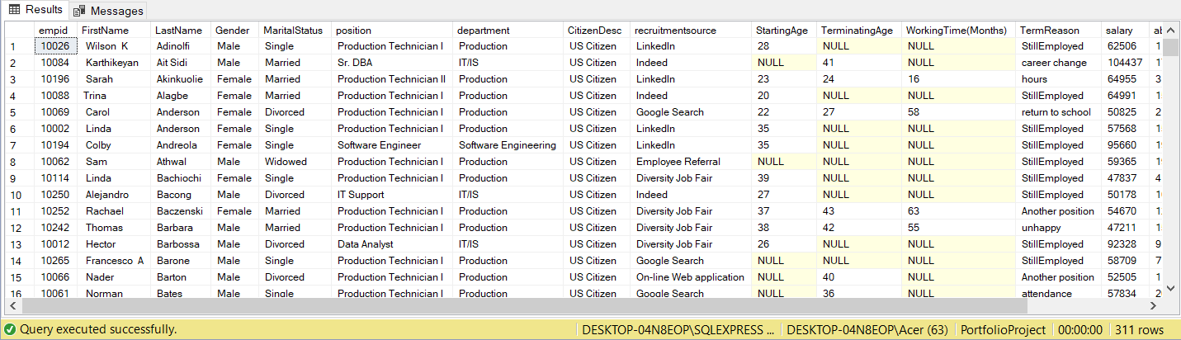
4. RESULT

Slide 7
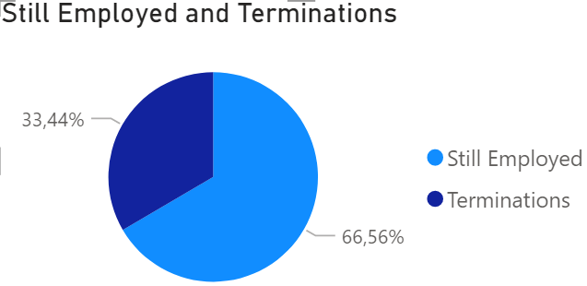
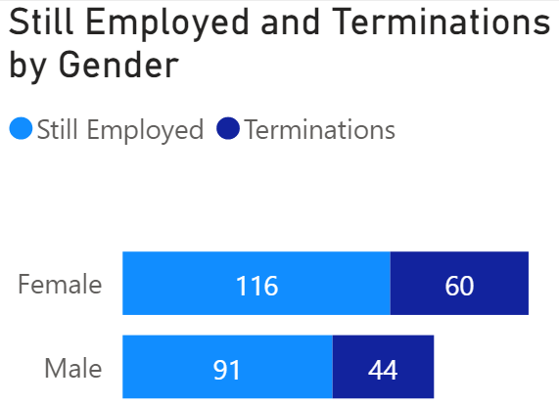
4.1.CHARTS
The company have 311 employees (terminated employees account for 33.44%). Average Salary per employee is $69,021 per year.
The number of terminated employees by sex is 44 people for male and 60 people for female.
Average salary per year by sex is $70,629 for male and $67,787 for female. Salary problem is one of the reason leading to termination

Slide 8
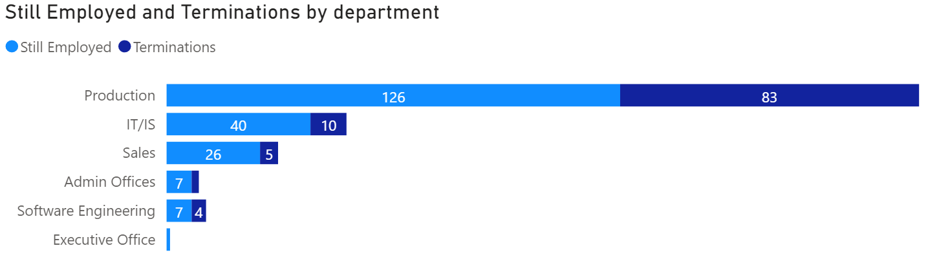
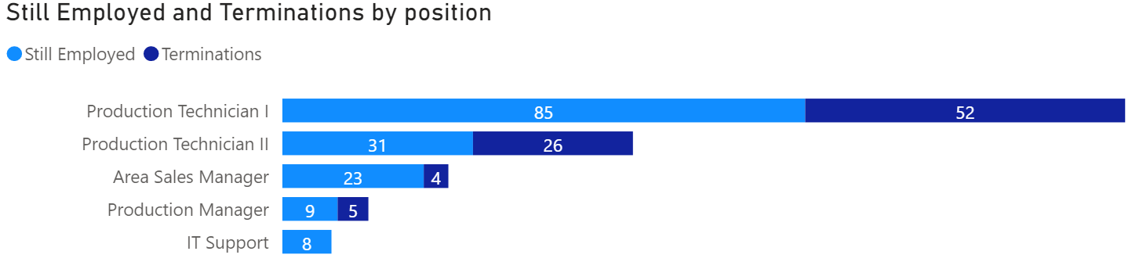
4.1.CHARTS
Most of the terminated employees come from Production Department (79.8%). Especially, average salary in this department lower than average salary in all departments. ($59,954 vs $69,021).
The majority of terminated position is Product Technician (75%).

Slide 9
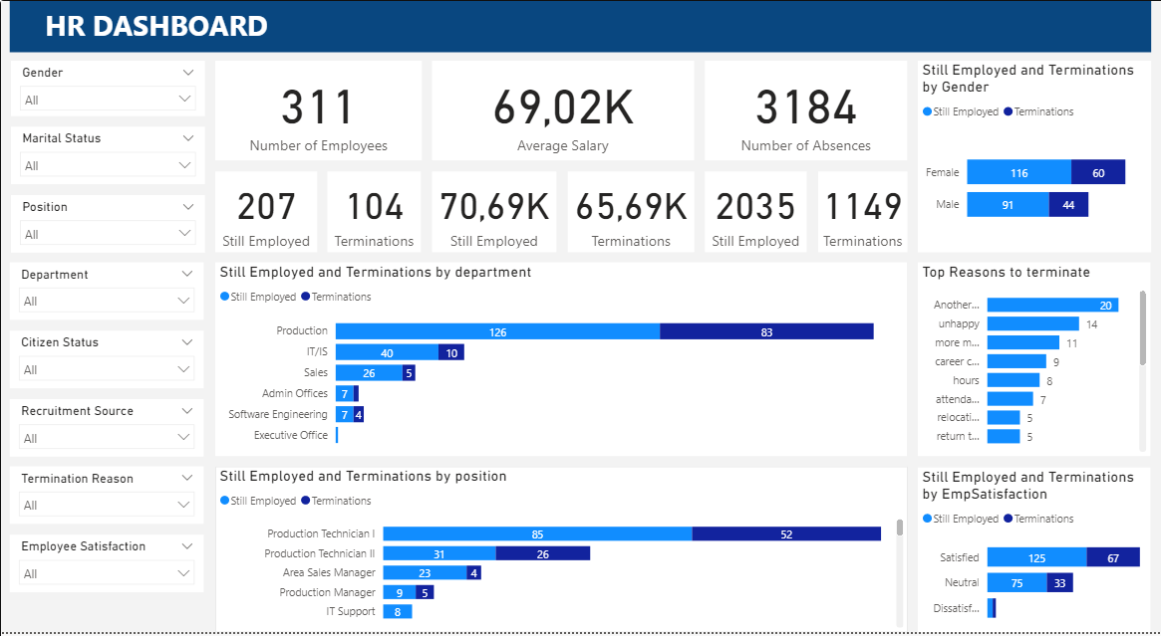
4.2. DASHBOARD

Slide 10

5. DISCUSSION
What’s the top reasons leading to termination of employment?
Give some solution to resolve the problem:
“Most of employees from
Product Department
termnated”.

Slide 11
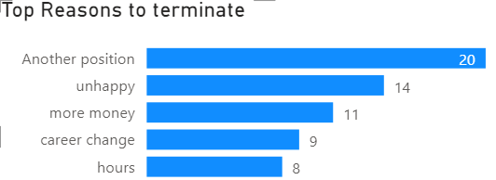
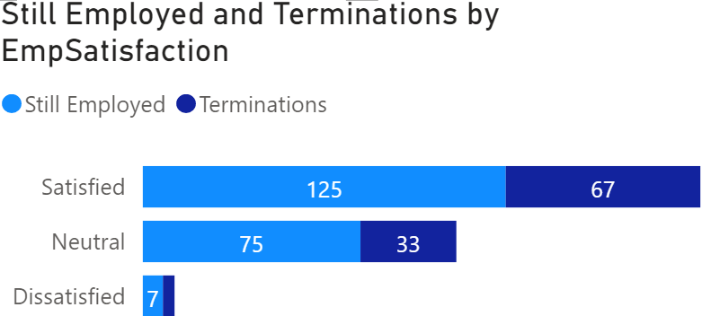
5.DISCUSSION
Another position is the most popular reason to terminate (19.23%).
Product department of salary lower than average salary leading to the majority of employees from this department decided to terminate ($59,954 vs $69,021).
One of the reasons make employees to terminate is working hour. Average of absences per person who still employing is 9.83, however the number for terminated employees is 11.05
There is only 3.56% employees dissatisfied.

Slide 12

SOLUTION
Create a positive, friendly working environment for staff.
Salary is suitable for work quality.
Build break time productively in workplace.

Slide 13

6. CONCLUSION
There is 33.4% employees decided to terminate.
Most of them from Product Department, especially Product Technician position (75% terminated employees).
Another position is the most popular reason to terminate (19.23%).
There is only 3.56% employees dissatisfied satisfaction survey of company.

